Slide 1
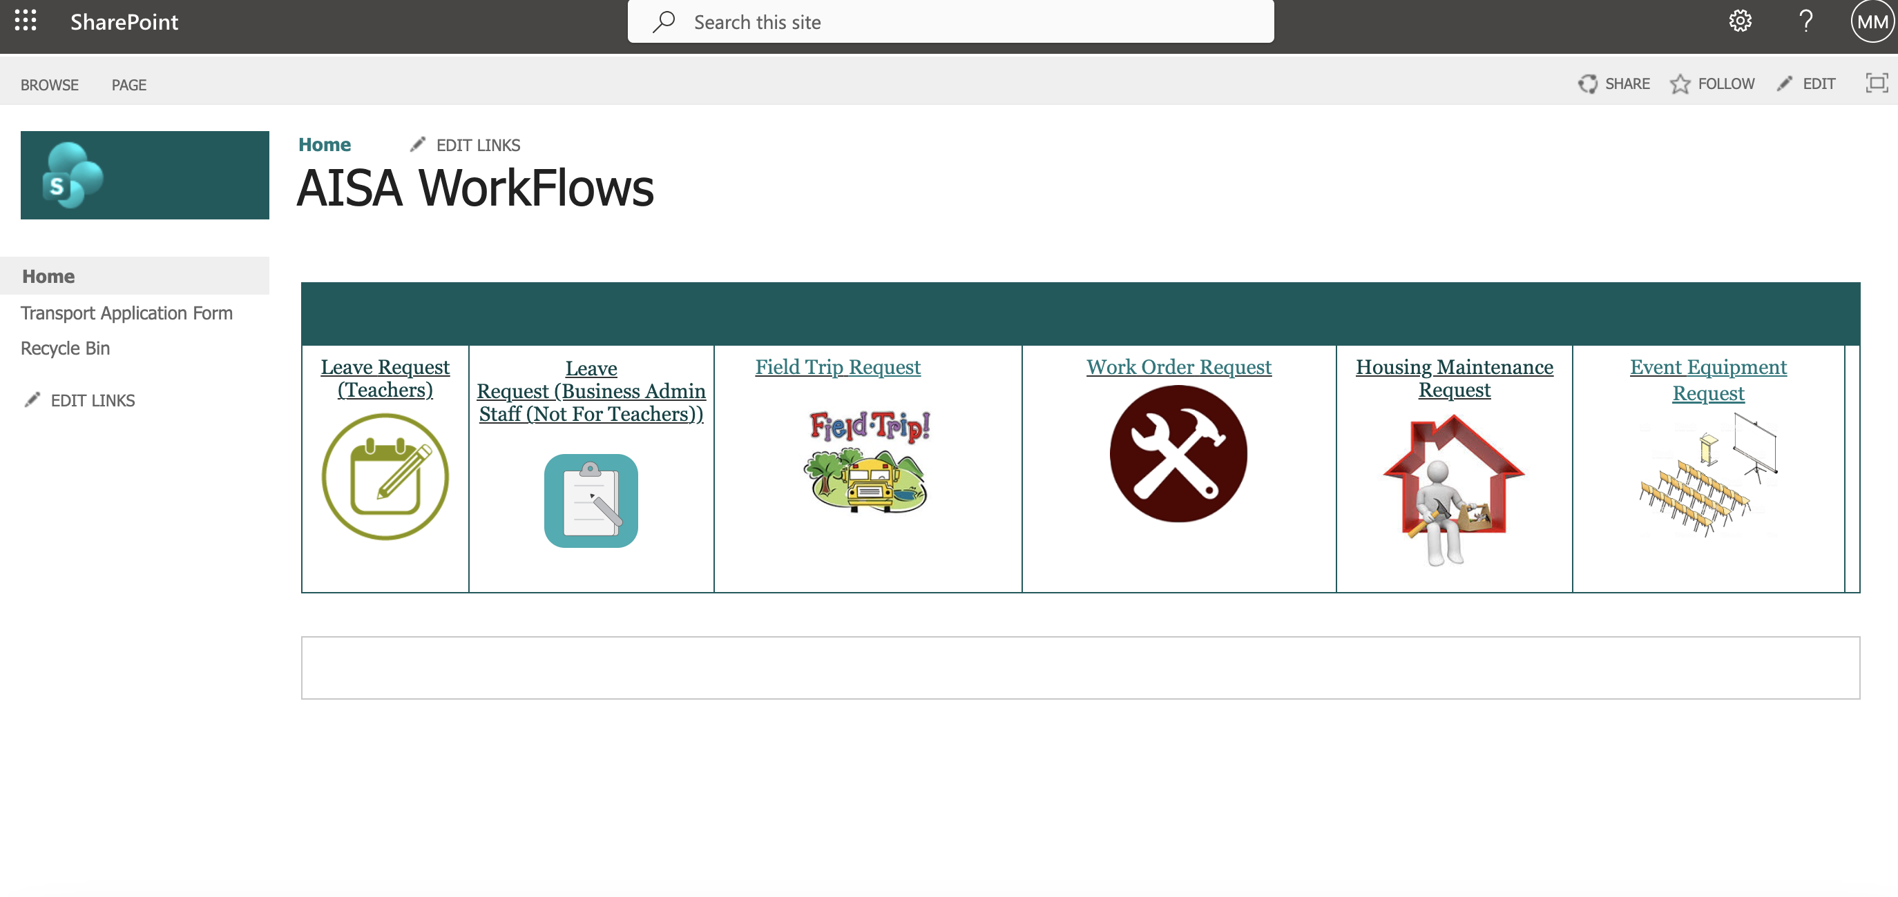
Sharepoint Application: AISA Workflow
Note: Leaves must be applied in advance

Slide 2
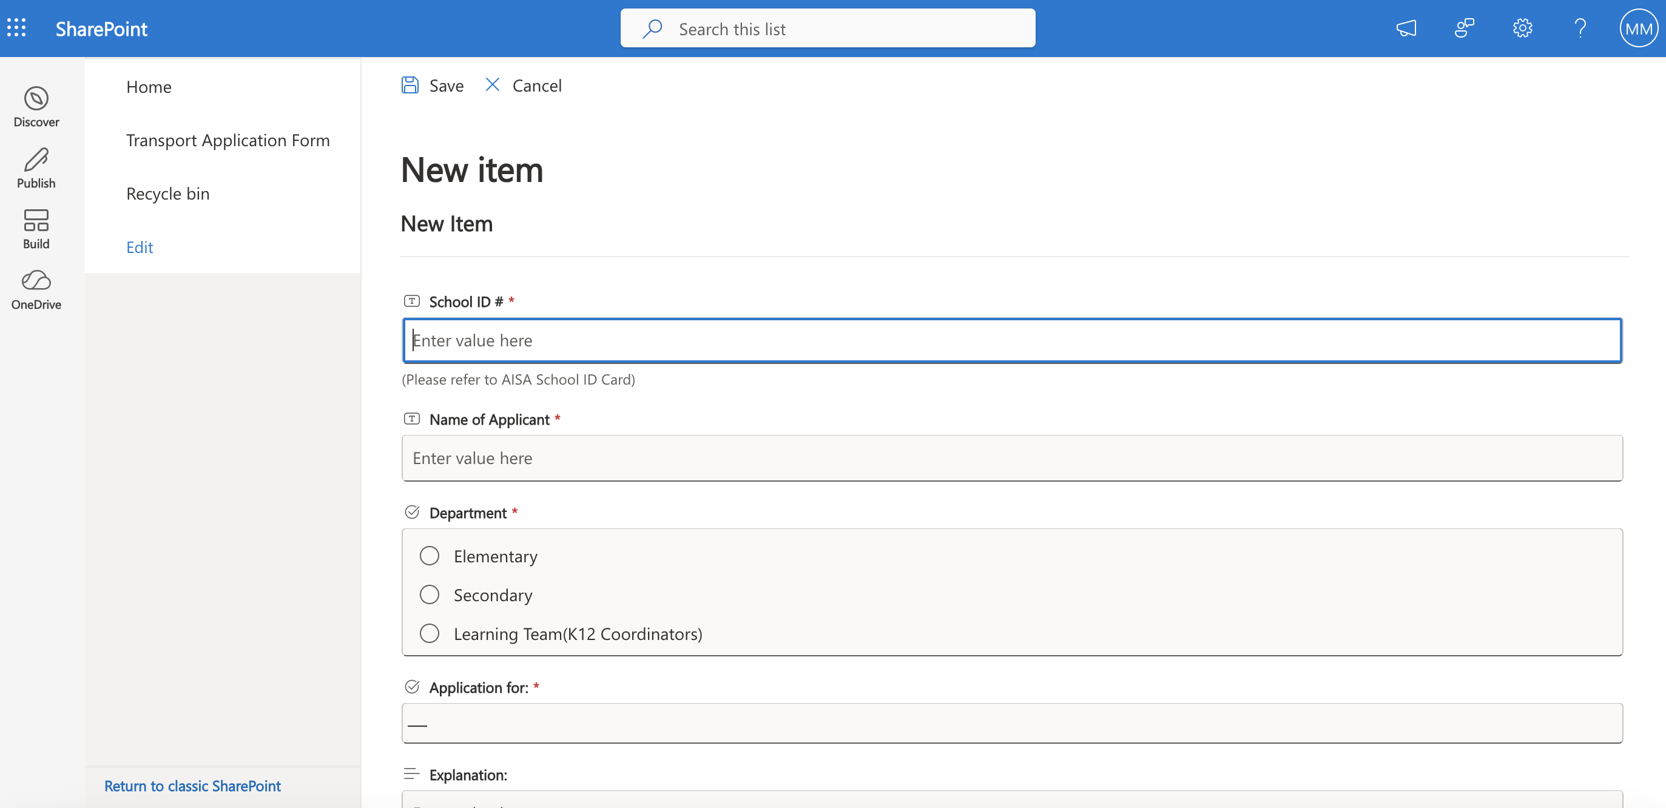
Faculty members must apply any leaves in this section – personal leave, sick leave, professional leave, etc. – types of leave are available in the dropdown selection.
By clicking the ‘Save’ button at the end, the application will be sent to the Principal for approval.

Slide 3
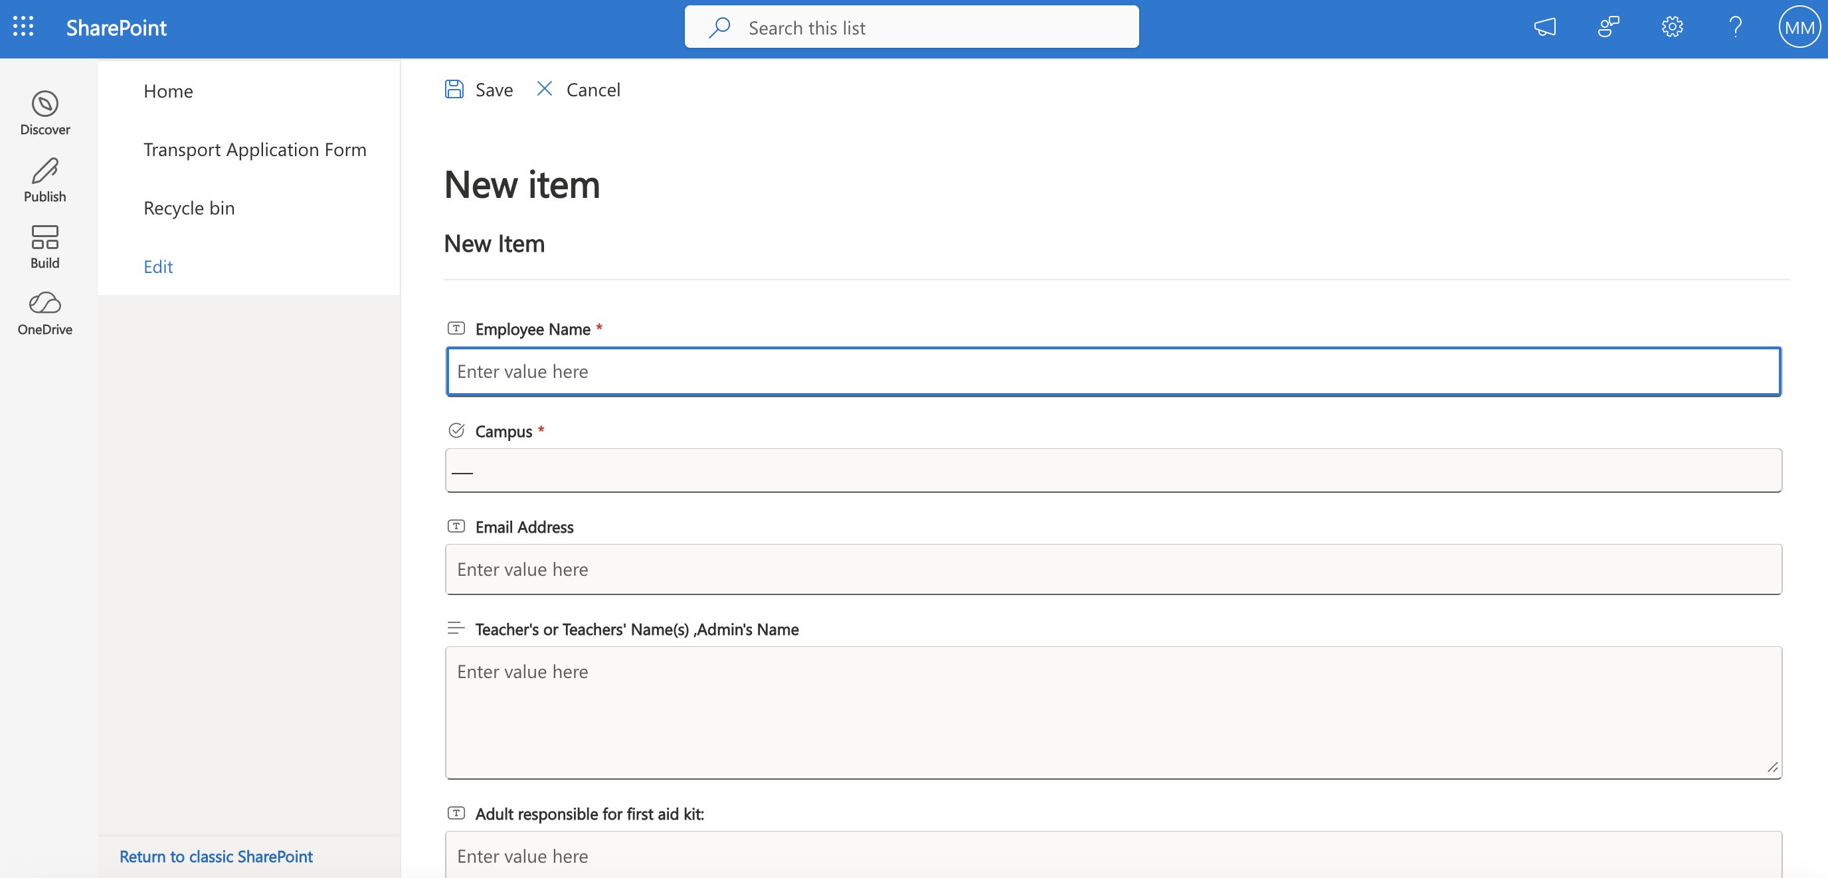
Admin, Teacher Assistants and all non-faculty members must apply any leaves in this section –sick leave, annual leave, professional leave, etc. – types of leave are available in the dropdown selection.
By clicking the ‘Save’ button at the end, the application will be sent to the Admin Manager for approval.

Slide 4
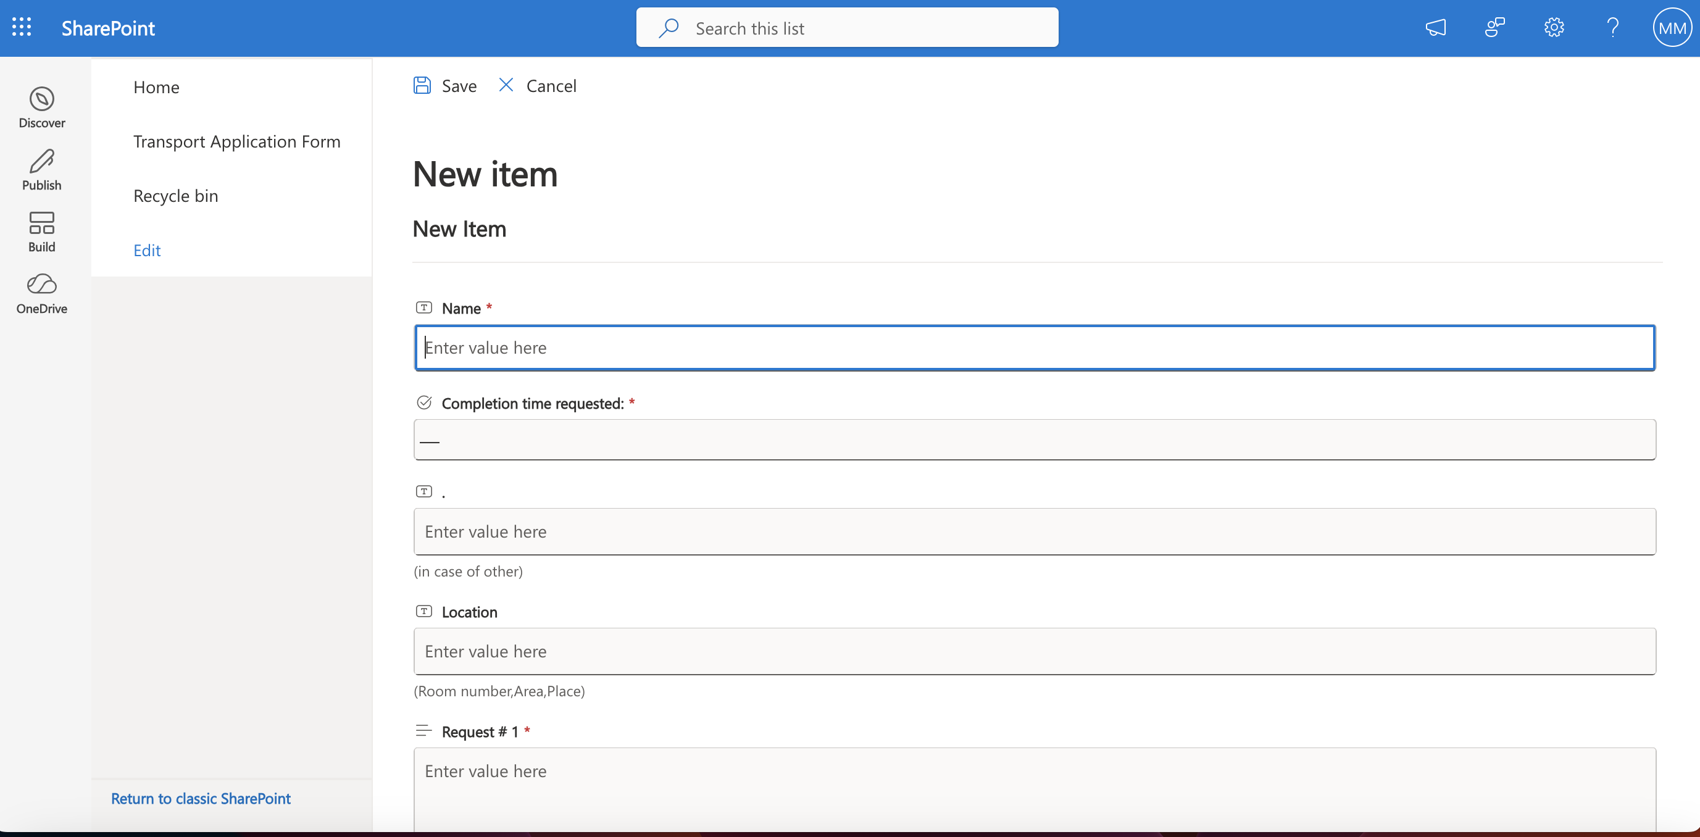
HOD / Authorized staff applies class field trip in this section.
By clicking the ‘Save’ button at the end, the application will be sent for approval.

Slide 5
Faculty members raised classroom / school facility work order request in here.
By clicking the ‘Save’ button at the end, notification will be sent the Health and Safety Officer and the school maintenance team.

Slide 6
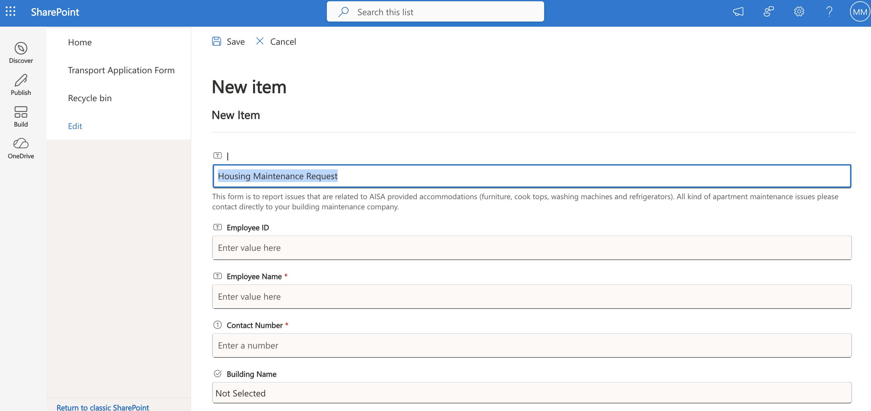
Faculty members provided with the school housing can raise request for maintenance here – only related to appliances and furniture provided by the school.
Any maintenance request related to the apartments’ infrastructure (i.e. plumbing, water leak, electrical, AC, etc), the staff must call the building maintenance provided behind the main door.
By clicking the ‘Save’ button at the end, notification will be sent to the HR, the Health and Safety and the maintenance team.

Slide 7
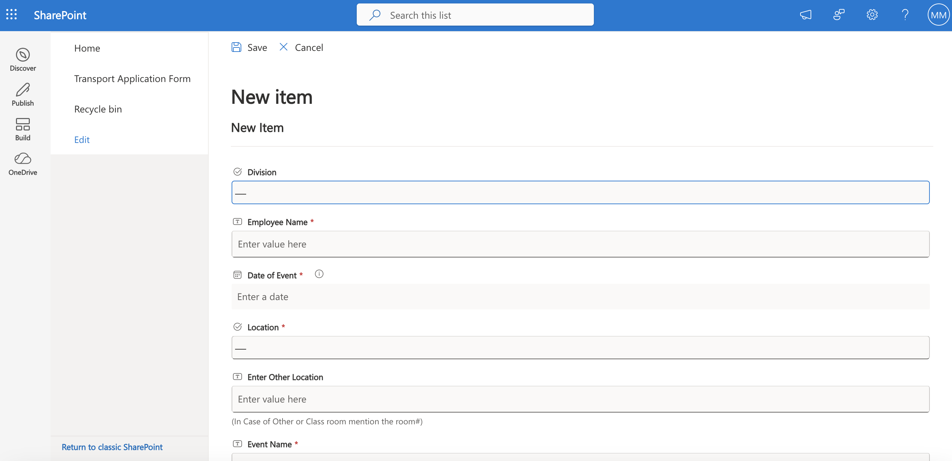
Faculty members needs to request for school equipement,
By clicking the ‘Save’ button at the end, notification will be sent to campus principak, the HR the Health and Safety and the maintenance team.

